Slide 1
ECE/CS 757: Advanced Computer Architecture II
Instructor:Mikko H Lipasti
Spring 2017
University of Wisconsin-Madison
Lecture notes based on slides created by John Shen, Mark Hill, David Wood, Guri Sohi, Jim Smith, Natalie Enright Jerger, Michel Dubois, Murali Annavaram, Per Stenström and probably others

Slide 2
Computer Architecture
Instruction Set Architecture (IBM 360)
  … the attributes of a [computing] system as seen by the programmer. I.e. the conceptual structure and functional behavior, as distinct from the organization of the data flows and controls, the logic design, and the physical implementation. -- Amdahl, Blaaw, & Brooks, 1964
Machine Organization (microarchitecture)
  ALUS, Buses, Caches, Memories, etc.
Machine Implementation (realization)
  Gates, cells, transistors, wires

Slide 3
757 In Context
Prior courses
  352 – gates up to multiplexors and adders
  354 – high-level language down to machine language interface or instruction set architecture (ISA)
  552 – implement logic that provides ISA interface
  CS 537 – provides OS background (co-req. OK)
This course – 757 – covers parallel machines
  Multiprocessor systems
  Data parallel systems
  Memory systems that exploit MLP
  Etc.
Additional courses
  ECE 752 covers advanced uniprocessor design (not a prereq)
    Will review key topics in next lecture
  ECE 755 covers VLSI design
  ME/ECE 759 covers parallel programming
  CS 758 covers special topics (recently parallel programming)

Slide 4
Why Take 757?
To become a computer designer
  Alumni of this class helped design your computer
To learn what is under the hood of a computer
  Innate curiosity
  To better understand when things break
  To write better code/applications
  To write better system software (O/S, compiler, etc.)
Because it is intellectually fascinating!
Because multicore/parallel systems are ubiquitous

Slide 5
Computer Architecture
Exercise in engineering tradeoff analysis
  Find the fastest/cheapest/power-efficient/etc. solution
  Optimization problem with 100s of variables
All the variables are changing
  At non-uniform rates
  With inflection points
  Only one guarantee: Today’s right answer will be wrong tomorrow
Two high-level effects:
  Technology push
  Application Pull

Slide 6
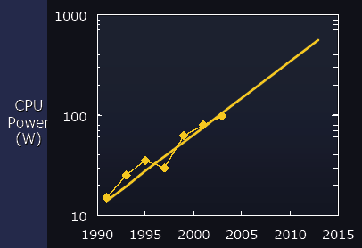
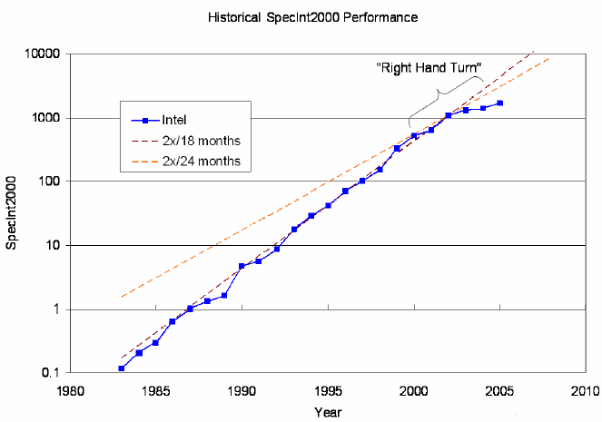
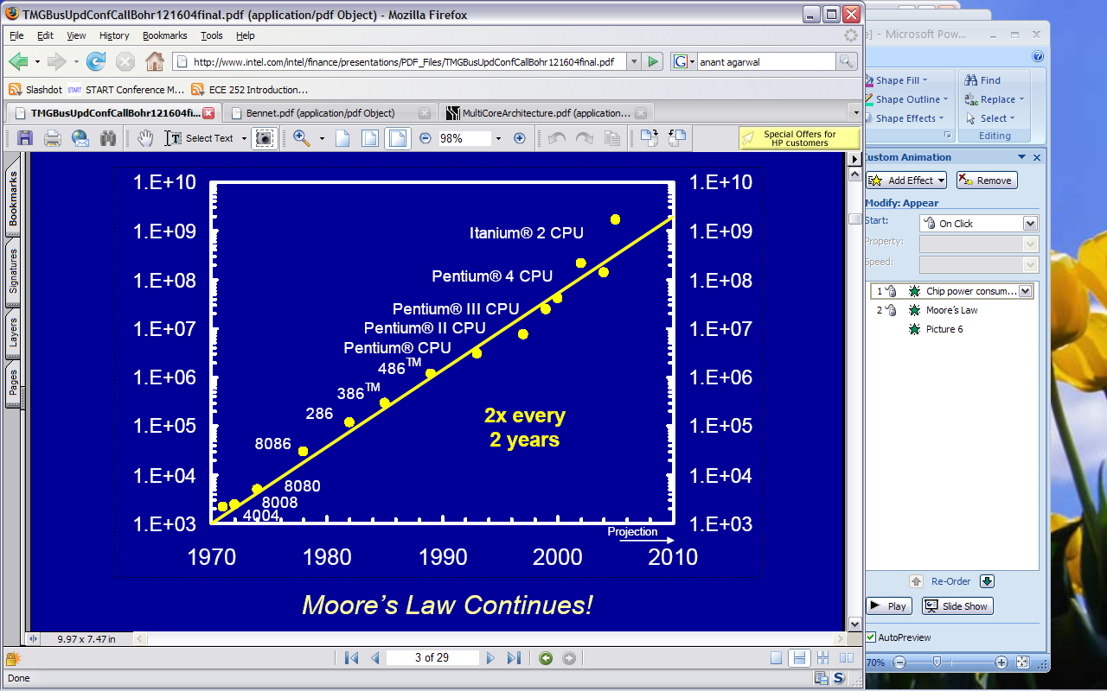
Trends
Moore’s Law for device integration
Chip power consumption
Single-thread performance trend
[source: Intel]
Mikko Lipasti-University of Wisconsin

Slide 7
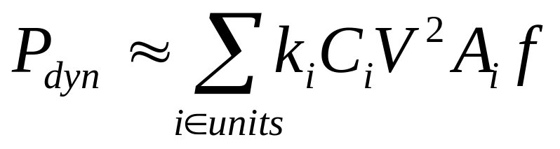
Dynamic Power
Static CMOS: current flows when active
  Combinational logic evaluates new inputs
  Flip-flop, latch captures new value (clock edge)‏
Terms
  C: capacitance of circuit
    wire length, number and size of transistors
  V: supply voltage
  A: activity factor
  f: frequency
Future: Fundamentally power-constrained
Mikko Lipasti-University of Wisconsin

Slide 8
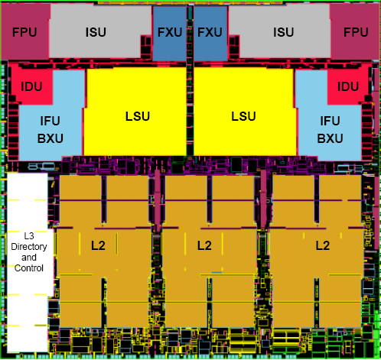
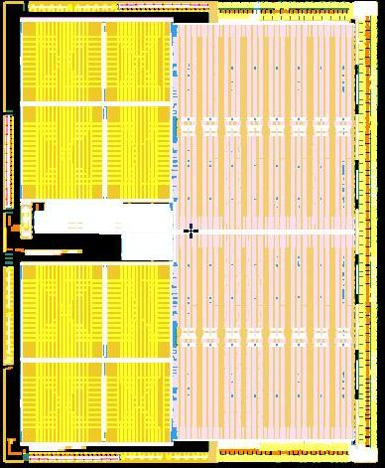
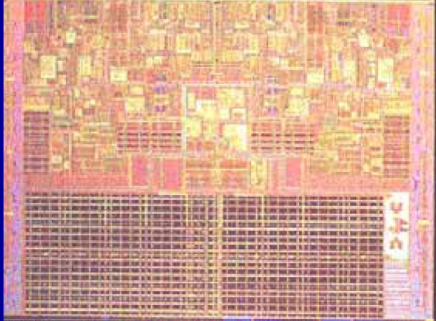
Multicore Mania
First, servers
  IBM Power4, 2001
Then desktops
  AMD Athlon X2, 2005
Then laptops
  Intel Core Duo, 2006
Now, cellphone & tablet
  Qualcomm, Nvidia Tegra, Apple A6, etc.
Mikko Lipasti-University of Wisconsin

Slide 9
Why Multicore
Core
Core
Core
Core
Core
Core
Core
 | Single Core | Dual Core | Quad Core
Core area | A | ~A/2 | ~A/4
Core power | W | ~W/2 | ~W/4
Chip power | W + O | W + O’ | W + O’’
Core performance | P | 0.9P | 0.8P
Chip performance | P | 1.8P | 3.2P
Mikko Lipasti-University of Wisconsin
Notes:
End of the “panacea” part of the talk

Slide 10
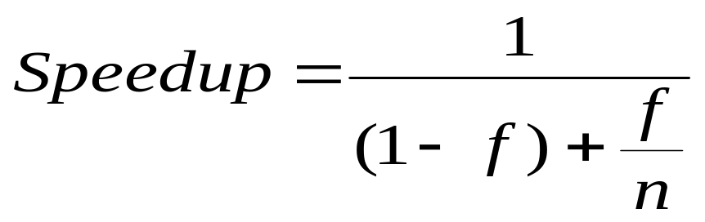
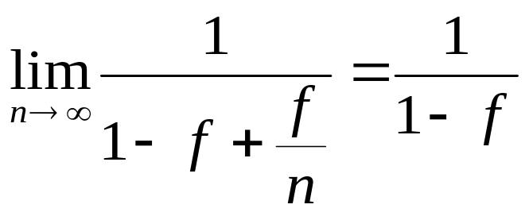
Amdahl’s Law
n
f
# CPUs
1
f
1-f
Time
f – fraction that can run in parallel
1-f – fraction that must run serially
Mikko Lipasti-University of Wisconsin

Slide 11
Fixed Chip Power Budget
n
# CPUs
f
1
1-f
Time
Amdahl’s Law
  Ignores (power) cost of n cores
Revised Amdahl’s Law
  More cores → each core is slower
  Parallel speedup < n
  Serial portion (1-f) takes longer
  Also, interconnect and scaling overhead
Mikko Lipasti-University of Wisconsin

Slide 12
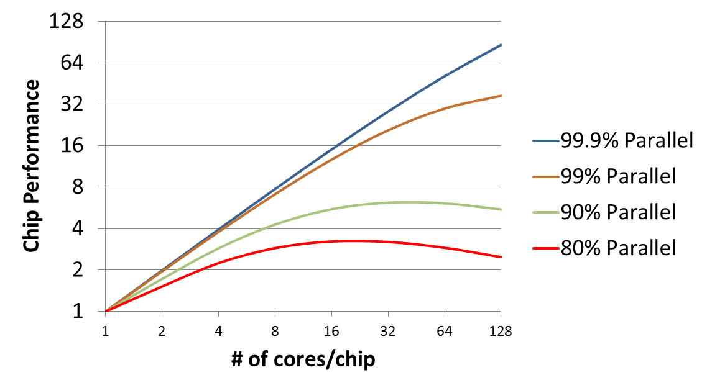
Fixed Power Scaling
Fixed power budget forces slow cores
Serial code quickly dominates
Mikko Lipasti-University of Wisconsin

Slide 13
Challenges
Parallel scaling limits many-core
  >4 cores only for well-behaved programs
  Optimistic about new applications
Interconnect overhead
Single-thread performance
  Will degrade unless we innovate
Parallel programming
  Express/extract parallelism in new ways
  Retrain programming workforce
Mikko Lipasti-University of Wisconsin

Slide 14
Finding Parallelism
Functional parallelism
  Car: {engine, brakes, entertain, nav, …}
  Game: {physics, logic, UI, render, …}
Automatic extraction
  Decompose serial programs
Data parallelism
  Vector, matrix, db table, pixels, …
Request parallelism
  Web, shared database, telephony, …
Mikko Lipasti-University of Wisconsin

Slide 15
Balancing Work
Amdahl’s parallel phase f: all cores busy
If not perfectly balanced
  (1-f) term grows (f not fully parallel)
  Performance scaling suffers
  Manageable for data & request parallel apps
  Very difficult problem for other two:
    Functional parallelism
    Automatically extracted
Mikko Lipasti-University of Wisconsin

Slide 16
Coordinating Work
Synchronization
  Some data somewhere is shared
  Coordinate/order updates and reads
  Otherwise → chaos
Traditionally: locks and mutual exclusion
  Hard to get right, even harder to tune for perf.
Research to reality: Transactional Memory
  Programmer: Declare potential conflict
  Hardware and/or software: speculate & check
  Commit or roll back and retry
  IBM, Intel, others, now support in HW
Mikko Lipasti-University of Wisconsin

Slide 17
Single-thread Performance
Still most attractive source of performance
  Speeds up parallel and serial phases
  Can use it to buy back power
Must focus on power consumption
  Performance benefit ≥ Power cost
Focus of 752; brief review coming up
Mikko Lipasti-University of Wisconsin

Slide 18
Focus of this Course
How to minimize these overheads
  Interconnect
  Synchronization
  Cache Coherence
  Memory systems
Also
  How to write parallel programs (a little)
  Non-cache coherent systems (clusters, MPP)
  Data-parallel systems

Slide 19
Expected Background
ECE/CS 552 or equivalent
  Design simple uniprocessor
  Simple instruction sets
  Organization
  Datapath design
  Hardwired/microprogrammed control
  Simple pipelining
  Basic caches
  Some 752 content (optional review)
High-level programming experience
  C/UNIX skills – modify simulators

Slide 20
About This Course
Readings
  Posted on website later this week
  Make sure you keep up with these! Often discussed in depth in lecture, with required participation
  Subset of papers must be reviewed in writing, submitted through learn@uw
Lecture
  Attendance required, pop quizzes
Homeworks
  Not collected, for your benefit only
  Develop deeper understanding, prepare for midterms

Slide 21
About This Course
Exams
  Midterm 1: Friday 3/3 in class
  Midterm 2: Monday 4/17 in class
  Keep up with reading list!
Textbook
  For reference:
    Dubois, Annavaram, Stenström, Parallel Computer Organization and Design, Cambridge Univ. Press, 2012.
    4 beta chapters from Jim Smith posted on course web site
  Additional references available as well
    Morgan Kauffman synthesis lectures (UW access only)

Slide 22
About This Course
Course Project
  Research project
    Replicate results from a paper
    Or attempt something novel
    Parallelize/characterize new application
  Proposal due 3/17, status report 4/21
Final project includes a written report and an oral presentation
  Written reports due 5/8
  Presentations during class time 5/1, 5/3

Slide 23
About This Course
Grading
  Homework, quizzes, paper reviews 20%
  Midterm 1 25%
  Midterm 2 25%
  Project 30%
Web Page (check regularly)
  http://ece757.ece.wisc.edu

Slide 24
About This Course
Office Hours
  Prof. Lipasti: EH 3621, TBD, or by appt.
Communication channels
  E-mail to instructor, class e-mail list
    ece757-1-s17@lists.wisc.edu
  Web page
    http://ece757.ece.wisc.edu
  Office hours

Slide 25
About This Course
Other Resources
  Computer Architecture Colloquium – Tuesday 4-5PM, 1240 CSS
  Computer Engineering Seminar – Friday 12-1PM, EH4610
  Architecture mailing list:
    http://lists.cs.wisc.edu/mailman/listinfo/architecture
  WWW Computer Architecture Page http://www.cs.wisc.edu/~arch/www

Slide 26
About This Course
Lecture schedule:
  MWF 1-2:15pm
  Cancel 1 of 3 lectures (on average)
  Free up several weeks near end for project work

Slide 27
Tentative Schedule (1st half)
Week | Dates | Topic
1 | 1/18, 1/20 | Introduction 752 review
2 | 1/23, 1/25 1/27 | Class cancelled Cores, multithreading, multicore
3 | 1/30, 2/1, 2/3 | MP Software Memory Systems
4 | 2/6, 2/8 2/10 | Class cancelled MP Memory Systems
5 | 2/13, 2/15, 2/17 | Coherence & consistency
6 | 2/20, 2/22, 2/24 | Coherence & consistency cont’d
7 | 2/27, 3/1 3/3 | Catch up / midterm review Midterm 1 in class on 3/3
8 | 3/6 3/8, 3/10 | Class cancelled Simulation Methodology Transactional Memory
9 | 3/13, 3/15, 3/17 | Interconnection Networks Project proposal due 3/17
N/A | 3/20, 3/22, 3/24 | Spring break

Slide 28
Tentative Schedule (2nd half)
Week | Dates | Topic
10 | 3/27, 3/29, 3/31 | SIMD MPP
11 | 4/3, 4/5 4/7 | Clusters, GPGPUs Class cancelled
12 | 4/10, 4/12, 4/14 | Catch up and review
13 | 4/17 4/19, 4/21 | Midterm 2 in class 4/17 No lecture; project work Project status report due 4/21
14 | 4/24, 4/26, 4/28 | No lecture; project work
15 | 5/1, 5/3 | Project talks, course Evaluation
16 | 5/8 | No final exam Project reports due 5/8

Slide 29
Brief Introduction to Parallel Computing
Thread-level parallelism
Multiprocessor Systems
Cache Coherence
  Snoopy
  Scalable
Flynn Taxonomy
UMA vs. NUMA

Slide 30
Thread-level Parallelism
Instruction-level parallelism (752 focus)
  Reaps performance by finding independent work in a single thread
Thread-level parallelism
  Reaps performance by finding independent work across multiple threads
Historically, requires explicitly parallel workloads
  Originates from mainframe time-sharing workloads
  Even then, CPU speed >> I/O speed
  Had to overlap I/O latency with “something else” for the CPU to do
  Hence, operating system would schedule other tasks/processes/threads that were “time-sharing” the CPU

Slide 31
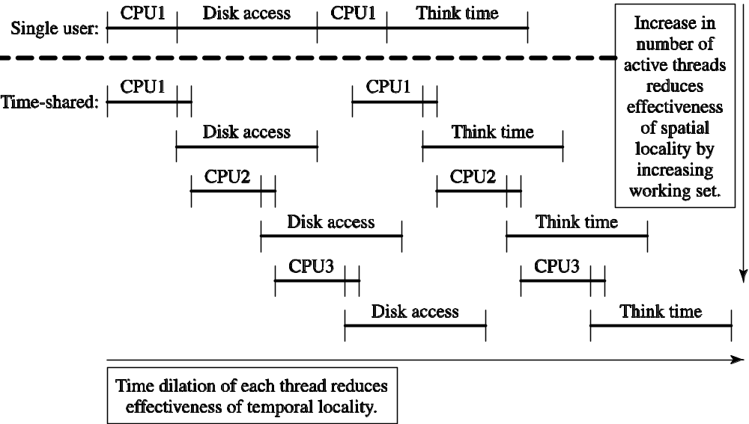
Thread-level Parallelism
Reduces effectiveness of temporal and spatial locality

Slide 32
Thread-level Parallelism
Initially motivated by time-sharing of single CPU
  OS, applications written to be multithreaded
Quickly led to adoption of multiple CPUs in a single system
  Enabled scalable product line from entry-level single-CPU systems to high-end multiple-CPU systems
  Same applications, OS, run seamlessly
  Adding CPUs increases throughput (performance)
More recently:
  Multiple threads per processor core
    Coarse-grained multithreading (aka “switch-on-event”)
    Fine-grained multithreading
    Simultaneous multithreading
  Multiple processor cores per die
    Chip multiprocessors (CMP)

Slide 33
Multiprocessor Systems
Primary focus on shared-memory symmetric multiprocessors
  Many other types of parallel processor systems have been proposed and built
  Key attributes are:
    Shared memory: all physical memory is accessible to all CPUs
    Symmetric processors: all CPUs are alike
  Other parallel processors may:
    Share some memory, share disks, share nothing
    Have asymmetric processing units
Shared memory idealisms
  Fully shared memory
  Unit latency
  Lack of contention
  Instantaneous propagation of writes
Notes:
USPTO -- Advanced Modern Processor Design
© 2005 Mikko Lipasti

Slide 34
Motivation
So far: one processor in a system
Why not use N processors
  Higher throughput via parallel jobs
  Cost-effective
    Adding 3 CPUs may get 4x throughput at only 2x cost
  Lower latency from multithreaded applications
    Software vendor has done the work for you
    E.g. database, web server
  Lower latency through parallelized applications
    Much harder than it sounds

Slide 35
Where to Connect Processors?
At processor?
  Single-instruction multiple data (SIMD)
At I/O system?
  Clusters or multicomputers
At memory system?
  Shared memory multiprocessors
  Focus on Symmetric Multiprocessors (SMP)

Slide 36
Connect at Processor (SIMD)
Interconnection Network
Data
Memory
Data
Memory
. . .
Data
Memory
Registers
Registers
Registers
. . .
ALU
ALU
ALU
Control
Processor
Instruction Memory
© 2005 Mikko Lipasti

Slide 37
Connect at Processor
SIMD Assessment
  Amortizes cost of control unit over many datapaths
  Enables efficient, wide datapaths
  Programming model has limited flexibility
    Regular control flow, data access patterns
SIMD widely employed today
  MMX, SSE, 3DNOW vector extensions
  GPUs from Nvidia and AMD

Slide 38
Connect at I/O
Connect with standard network (e.g. Ethernet)
  Called a cluster
  Adequate bandwidth (GB Ethernet, going to 10GB)
  Latency very high
  Cheap, but “get what you pay for”
Connect with custom network (e.g. IBM SP1,SP2, SP3)
  Sometimes called a multicomputer
  Higher cost than cluster
  Poorer communication than multiprocessor
Internet data centers built this way

Slide 39
Connect at Memory: Multiprocessors
Shared Memory Multiprocessors
  All processors can address all physical memory
  Demands evolutionary operating systems changes
  Higher throughput with no application changes
  Low latency, but requires parallelization with proper synchronization
Most successful: Symmetric MP or SMP
  2-64 microprocessors on a “bus”
  Still use cache memories

Slide 40
Cache Coherence Problem
Load A
P0
P1
Load A
Store A<= 1
Load A
A
0
1
A
0
Memory

Slide 41
Cache Coherence Problem
Load A
P0
P1
Load A
Store A<= 1
Load A
A
0
A
0
1
A
1
Memory

Slide 42
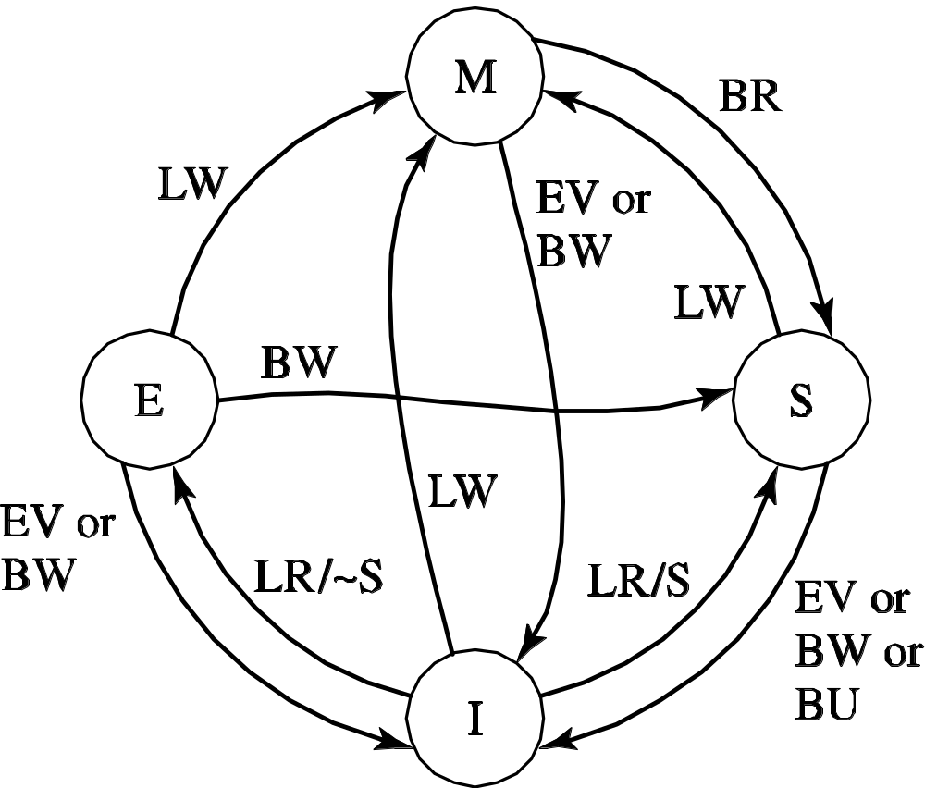
Sample Invalidate Protocol (MESI)
BR

Slide 43
Sample Invalidate Protocol (MESI)
Current State s | Event and Local Coherence Controller Responses and Actions (s' refers to next state)
 | Local Read (LR) | Local Write (LW) | Local Eviction (EV) | Bus Read (BR) | Bus Write (BW) | Bus Upgrade (BU)
Invalid (I) | Issue bus read if no sharers then s' = E else s' = S | Issue bus write s' = M | s' = I | Do nothing | Do nothing | Do nothing
Shared (S) | Do nothing | Issue bus upgrade s' = M | s' = I | Respond shared | s' = I | s' = I
Exclusive (E) | Do nothing | s' = M | s' = I | Respond shared s' = S | s' = I | Error
Modified (M) | Do nothing | Do nothing | Write data back; s' = I | Respond dirty; Write data back; s' = S | Respond dirty; Write data back; s' = I | Error

Slide 44
Snoopy Cache Coherence
All requests broadcast on bus
All processors and memory snoop and respond
Cache blocks writeable at one processor or read-only at several
  Single-writer protocol
Snoops that hit dirty lines?
  Flush modified data out of cache
  Either write back to memory, then satisfy remote miss from memory, or
  Provide dirty data directly to requestor
  Big problem in MP systems
    Dirty/coherence/sharing misses

Slide 45
Scaleable Cache Coherence
Eschew physical bus but still snoop
  Point-to-point tree structure
  Root of tree provides ordering point
Or, use level of indirection through directory
  Directory at memory remembers:
    Which processor is “single writer”
      Forwards requests to it
    Which processors are “shared readers”
      Forwards write permission requests to them
  Level of indirection has a price
    Dirty misses require 3 hops instead of two
      Snoop: Requestor->Owner->Requestor
      Directory: Requestor->Directory->Owner->Requestor

Slide 46
Flynn Taxonomy
Flynn (1966) | Single Data | Multiple Data
Single Instruction | SISD | SIMD
Multiple Instruction | MISD | MIMD
MISD
  Fault tolerance
  Pipeline processing/streaming or systolic array
Now extended to SPMD
  single program multiple data
Mikko Lipasti-University of Wisconsin

Slide 47
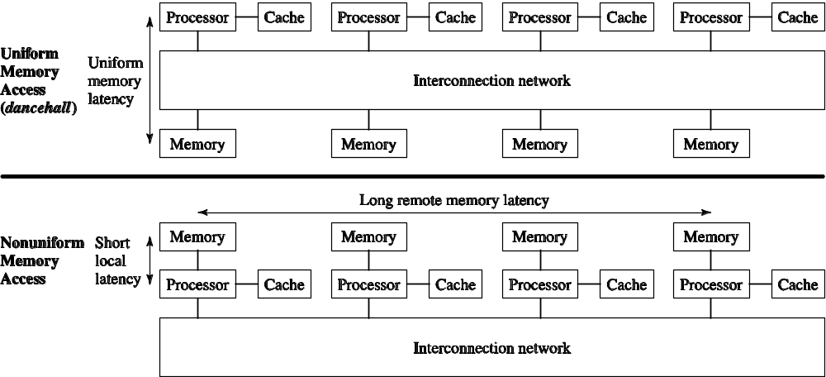
Memory Organization: UMA vs. NUMA
Mikko Lipasti-University of Wisconsin
Notes:
USPTO -- Advanced Modern Processor Design
© 2005 Mikko Lipasti

Slide 48
Memory Taxonomy
For Shared Memory | Uniform Memory | Nonuniform Memory
Cache Coherence | CC-UMA | CC-NUMA
No Cache Coherence | NCC-UMA | NCC-NUMA
NUMA wins out for practical implementation
Cache coherence favors programmer
  Common in general-purpose systems
NCC widespread in scalable systems
  CC overhead is too high, not always necessary
Mikko Lipasti-University of Wisconsin

Slide 49
Example Commercial Systems
CC-UMA (SMP)
  Sun E10000: http://doi.ieeecomputersociety.org/10.1109/40.653032
CC-NUMA
  SGI Origin 2000: The SGI Origin: A ccnuma Highly Scalable Server
NCC-NUMA
  Cray T3E: http://www.cs.wisc.edu/~markhill/Misc/asplos96_t3e_comm.pdf
Clusters
  ASCI: https://str.llnl.gov/str/April05/Seager.html

Slide 50
Summary
Thread-level parallelism
Multiprocessor Systems
Cache Coherence
  Snoopy
  Scalable
Flynn Taxonomy
UMA vs. NUMA

